Slide 1
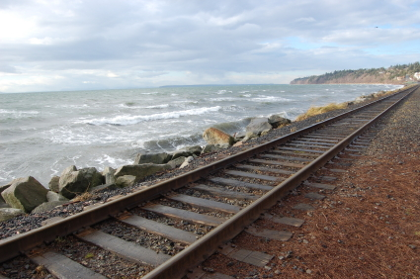
The National Dream

Slide 2
The Dream
MacDonald wanted to build a transportation and communication link that would join all parts of British North America.
Railway had to be built quickly
Needed $$$
Wanted people who would underwrite the project in return for financial benefits from the government once the railway was built
Sir Hugh Allan had lots of money from shipping and manufacturing
Allan decided to build the railway- only with USA backing

Slide 3
The Pacific Scandal
In 1872, MacDonald called a general election
Conservatives realized that they didn’t have enough money to woo voters successfully
Asked if Hugh Allen would finance the election in return for a guaranteed railway contract
Wrote memo’s that made it seem like Allan was on MacDonald’s payroll
MacDonald’s government resigned in 1873

Slide 4
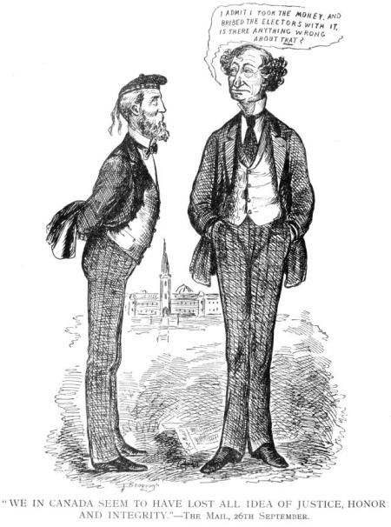

Slide 5
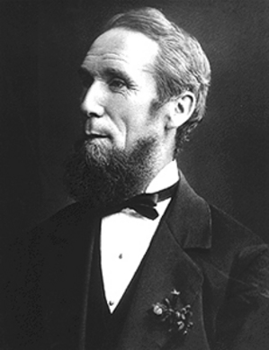
Mackenzie
Alexander Mackenzie led the liberals to power in 1873
Disagreed with MacDonald’s vision of a nation linked by rail
Thought it was too expensive
No railway construction during his administration

Slide 6
The National Policy
MacDonald and the Conservative Party began to recover from the effects of the Pacific Scandal
Developed The National Policy
System of Protective Tariffs
Protect Canadian manufacturing, mining and agriculture from American goods being too expensive for the Canadian market
Western Settlement
Encourage the settlement of the West by farmers so the profit they made from exporting grains would be used to produce manufactured goods in the East.
CPR
The West could not develop as a centre for agricultural export until goods could be transported in and out of the region
CPR=government’s top priority

Slide 7
CPR
Found private investors to support the project
Called the CPR Syndicate
George Stephen (Bank of Montreal)
Donald Smith (HBC)
James J. Hill (ex-pat in investment)
Upon completion of the railway, the government would hand over
$25 million
25 mill acres of land
Received a monopoly on all rail traffic west of Lake Superior for the next 25 years
Exemption from taxes on land until they were sold
Promised to have the railway completed in 10 years.

Slide 8
Route Change
Changed the route of the railway
Originally moved through Saskatoon
Many speculators had moved in, buying land they hoped would be near the rail line
Syndicate members wanted complete control
Gave the CPR control over the location of new towns and railway stations
How would the railway get through the Rockies?

Slide 9
Building of the CPR
Began in 1881
By winter, only 230 km’s of track had been laid
Needed a general manager of the railway

Slide 10
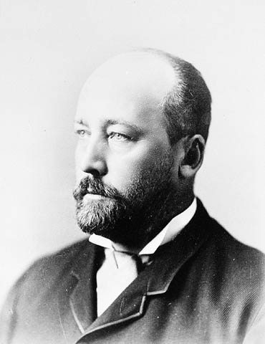
Van Horne
William Van Horne
Spent the next 4 years driving himself and employees unmercifully until the CPR was complete
Very efficient
Would be able to complete the railway line in the contracted period… if there was enough money.

Slide 11
$$$$$
All the money had been spent on the construction of the Prairie section- which was the easiest
Workers’ went on strike
Canadian government gave the CPR $22.5 million
Started cutting corners- using temporary wooden trestles to carry over
Money was almost used up by 1884…

Slide 12
The Workers
35 000 workers were involved
Working and living conditions were horrible
Unhealthy diet
Dangerous
Dynamite blasts
No medical facilities/ worker’s compensation
Who were the majority
of workers?

Slide 13
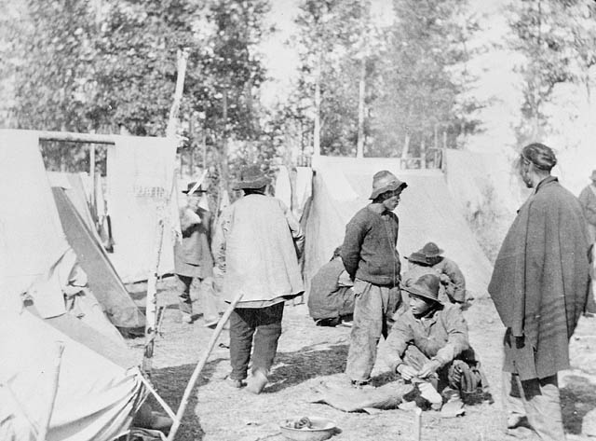
Chinese Workers
More than 15000 Chinese immigrants worked on the CPR
Only paid half of what others were paid
Extremely dangerous conditions
After the railway completion, Canadians wanted the Chinese to leave
Head tax
They were the only group in Canadian history to be subject to a race based head tax

