Slide 1
Toward Confederation

Slide 2
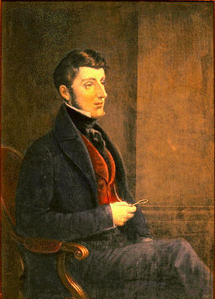
What Led to Confederation?
Lord Durham had recommended joining Upper and Lower Canada.
Lower Canada did not want this but the British Government favored the plan and acted immediately.
Lord Sydenham declared the Act of Union in 1840.

Slide 3
Responsible Government
Durham also recommended responsible government which was the idea that the colonies would govern themselves.
No one knew how self-government would work!
The British Empire was worried that this would weaken them and give strength to their political enemies.
Everyone wanted to stick with mercantilism; an economic system based on colonialism where the home country uses raw goods imported from the colonies to manufacture goods.

Slide 4
Economic Pressures: Corn Law
In 1846, the British government repealed the Corn Laws, which gave preferential treatment to British colonies. Canadian grain came into Britain with lower tariffs (a charge) than grain from other countries.
By changing this laws and not having to buy Canadian grain, Britain could buy wheat, flour and other products at the lowest price… from any country.

Slide 5
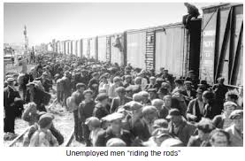
Economic Depression
This drove the colonies into a economic depression; period of low economic activity marked by high unemployment.
Canadians exported timber and agricultural products but manufactured very little.
Canadians began looking at the union of all the colonies as a way of helping their economy.

Slide 6
Confederation
If the colonies in Canada joined together, that would mean larger markets, more industry and better transportation systems.
A more independent Canadian government could develop its own economic polices… that would serve Canada!
To achieve this, self-government was needed!

